Slide 1
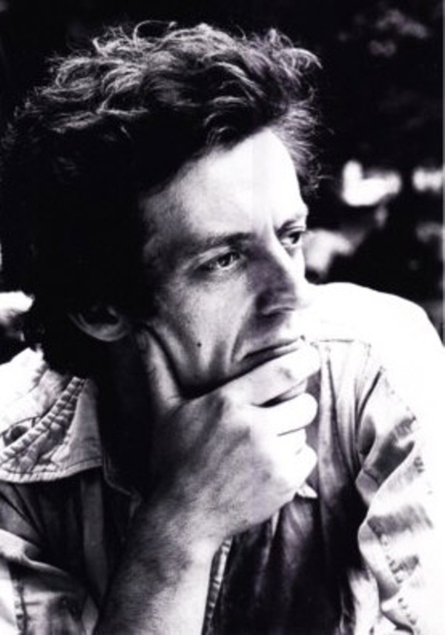
Cornelius Cardew

Slide 2
Bio
Was born on May 7, 1963 in Winchcombe, England
He began his musical education as a member of the chorus at Canterbury Cathedral joining in 1964 and continuing through 1953.
In 1953, at the age of 17 he entered the Royal Academy of Music in London.
After graduating from the academy in 1957. He traveled to Germany to study in the Cologne-based electronic music studio of composer Gottfried Michael Koenig.
Cardew then joined Karlheinz Stockhausen as his assistant.

Slide 3
Bio
He returned to England in 1961, supporting himself by working as a graphic artist and organizing concerts.
In 1966 he joined a improvisational electronic group AMM.
In 1968 Cardew, Michael Parsons, and Howard Skempton formed the Scratch Orchestra, which improvised music from verbal instructions and other minimalist prompts.
Around 1970 Cardew became increasingly involved in the leftist political trough inspired by the works of Mao Zedong.
On December 13, 1981 Cardew died in a hit-and-run car accident near his London home.

Slide 4
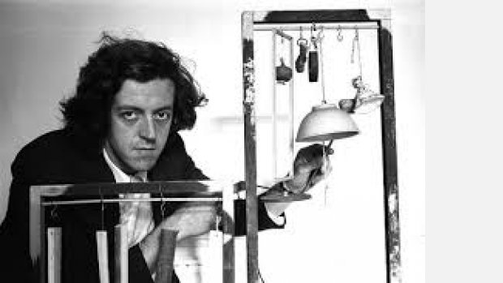
Political Movement
Marxist-Leninist
  the political and economic theories of Lenin which provided the guiding doctrine of the Soviet Union; the modification of Marxism by Lenin stressed that imperialism is the highest form of capitalism (which shifts the struggle from developed to underdeveloped countries)

Slide 5
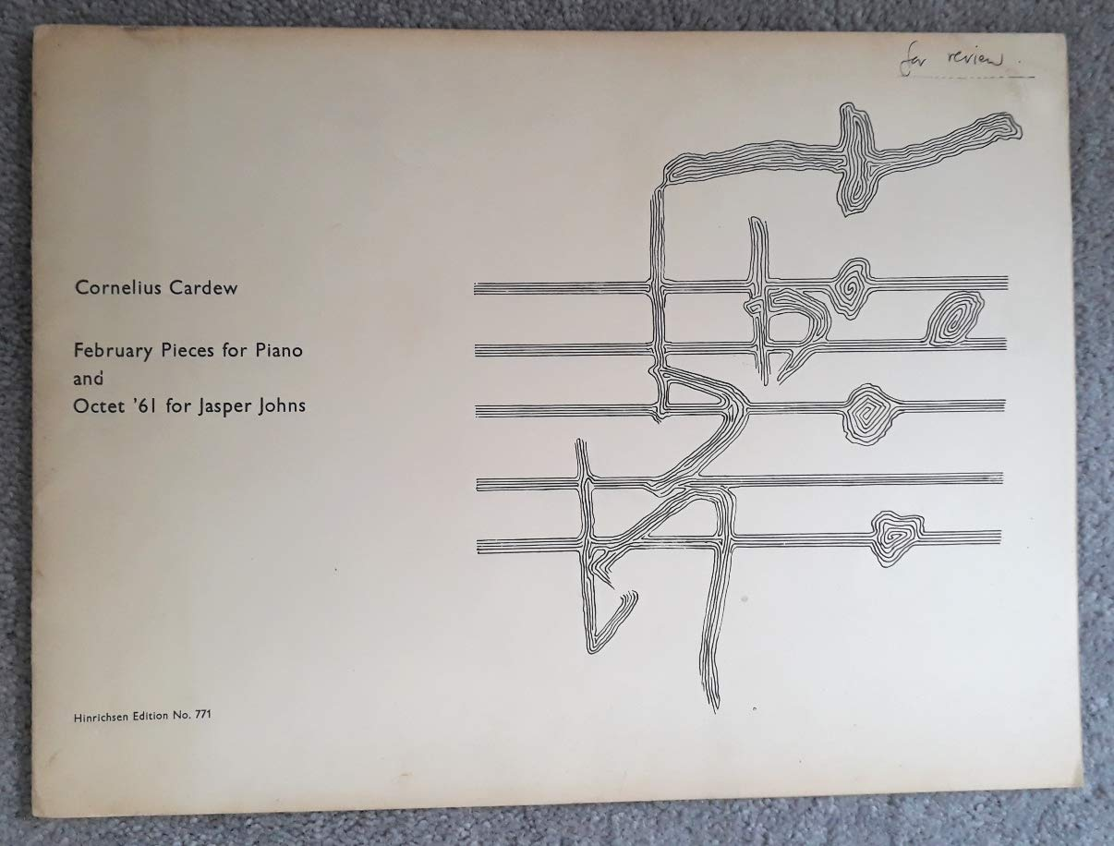
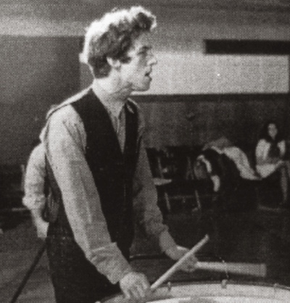
Pieces
Autumn '60,
Octet for Jasper Johns,
Solo with Accompaniment,
and Memories of You

Slide 6
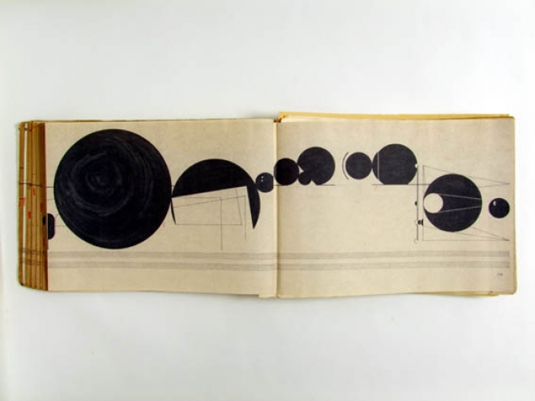
Treatise
A musical score containing 193 pages, composed in 1967.
No duration or instrument is specified.
The performer decides how to play the music.

Slide 7
Sometimes, the score is a stimulus for improvisation.
Sometimes, the performer attaches a sound to a symbol.
As the symbols develop, the sound varies.

Slide 8
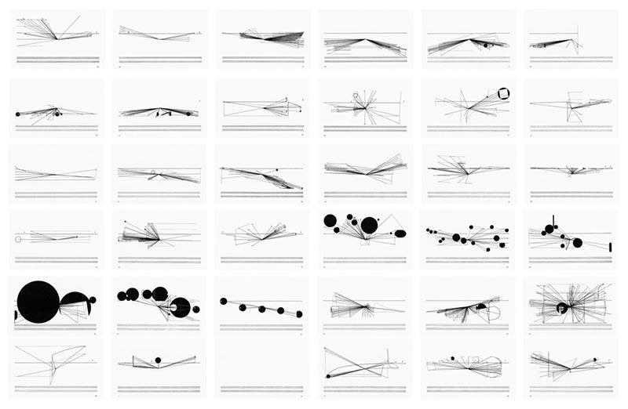
Graphic Scores from “Treatise”

Slide 9
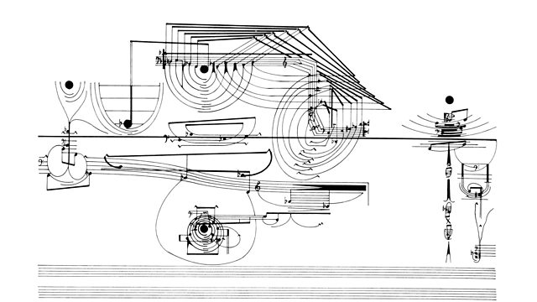

Slide 10
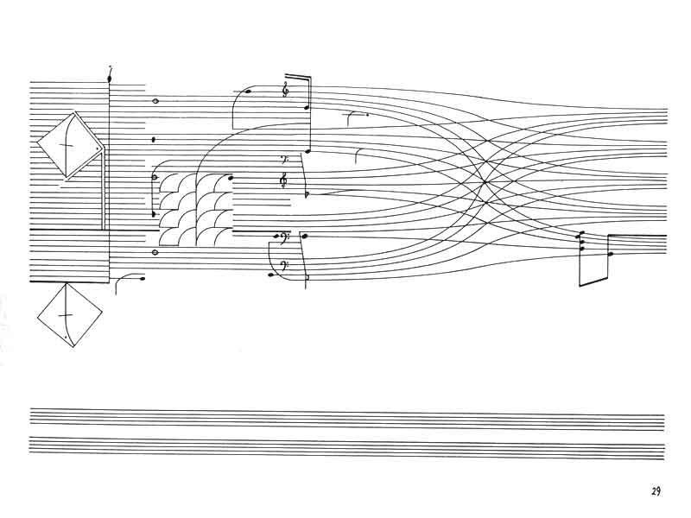
Conventionally, pages of sheet music
are images of notes on the stave.

Slide 11
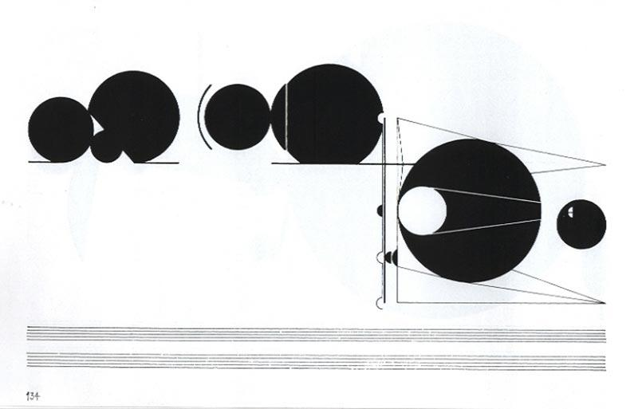
Cardew creates images that convey:
Motion and scale.

Slide 12
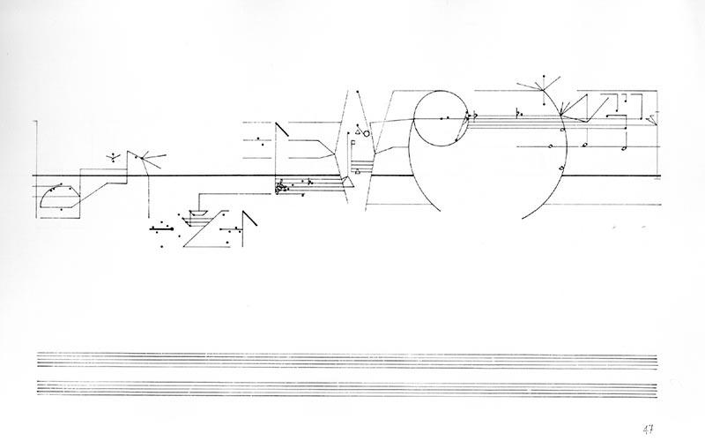

Slide 13
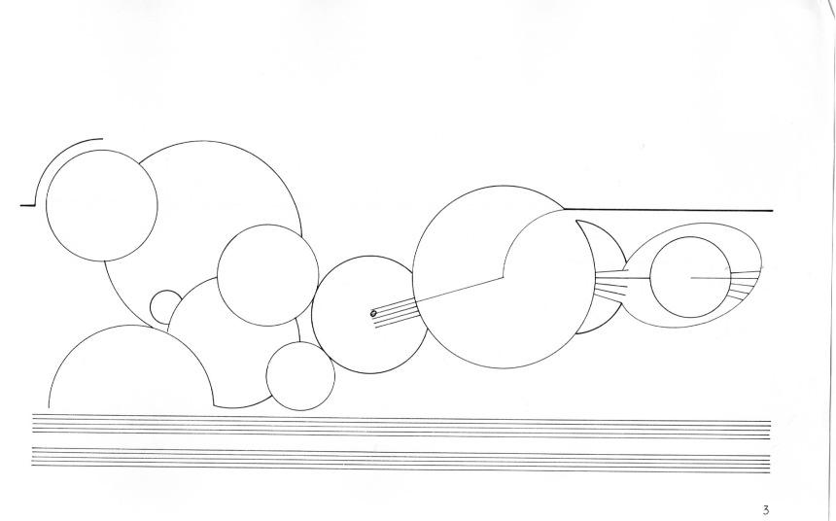
The process begins with an evolving representation of geometric circles, lines, numbers and patterns.
The only consistent theme is the pair of staves at the bottom of each page.

Slide 14
This allows freedom to the performer.
Freedom to interpret the ‘music’ for themselves.
This process ensures the music heard
will be different each time.

Slide 15
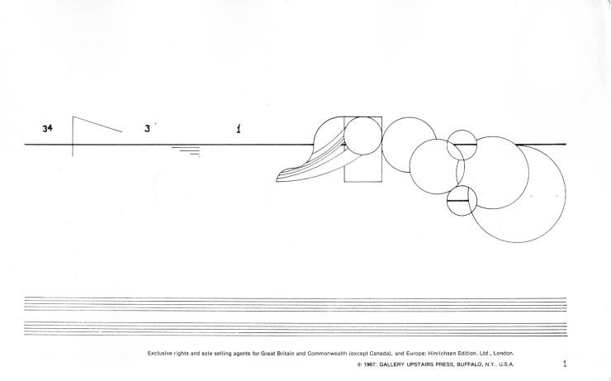

Slide 16
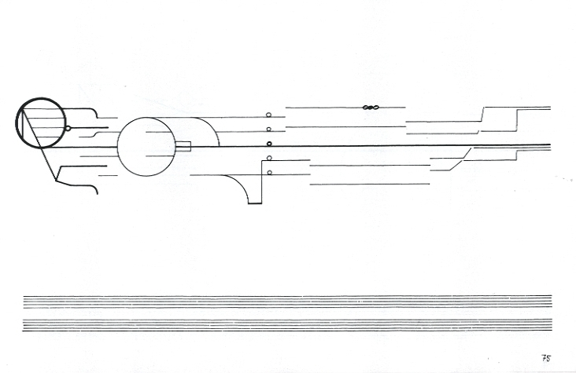

Slide 17
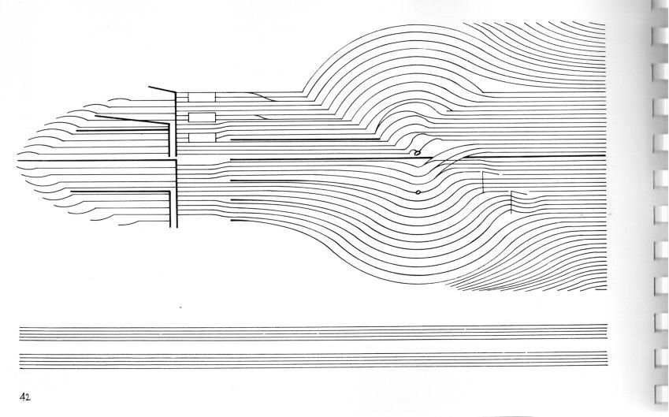

Slide 18
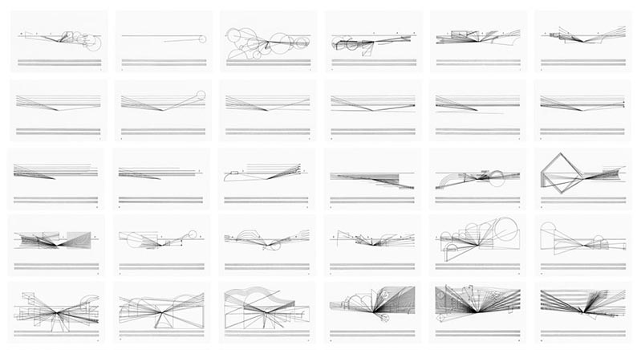

Slide 19
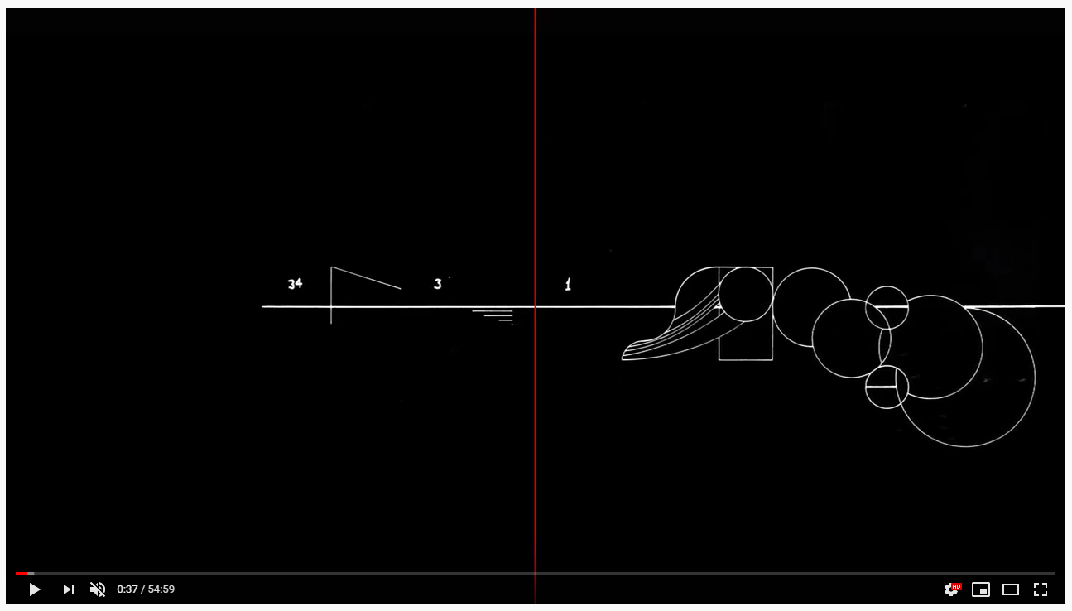
KYMATIC ensemble performing TREATISE
https://youtu.be/b0V9_xqaw8Q

Slide 20

Sources
https://www.theguardian.com/music/2008/nov/04/cornelius-cardew-john-tilbury
https://en.wikipedia.org/wiki/Cornelius_Cardew
https://britishmusiccollection.org.uk/composer/cornelius-cardew
https://www.discogs.com/artist/177584-Cornelius-Cardew
http://davidhall.io/treatise-score-graphic-notation/

